Slide 1
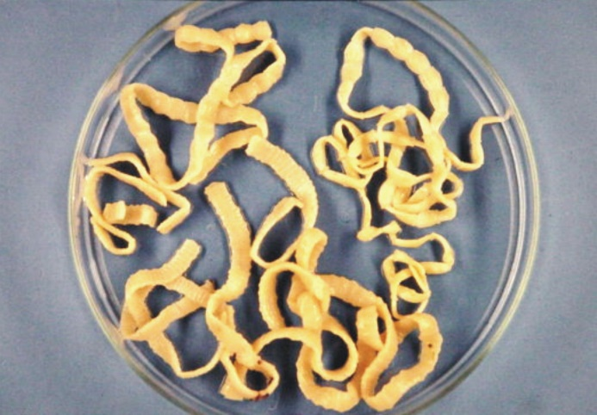
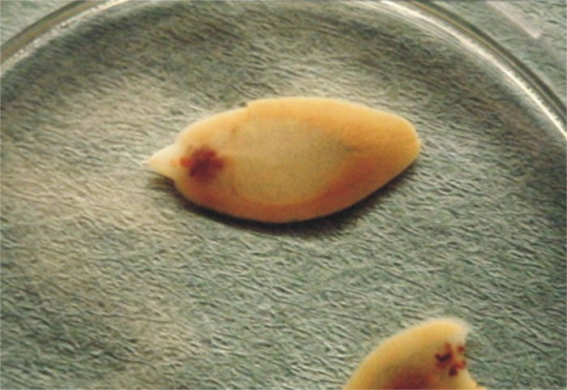


Helminthology
Prof.Dr. med. Clarissa Prazeres thereCosta
Institute of Medical Microbiology, Immunology and Hygiene
clarissa.dacosta@tum.de

Slide 2
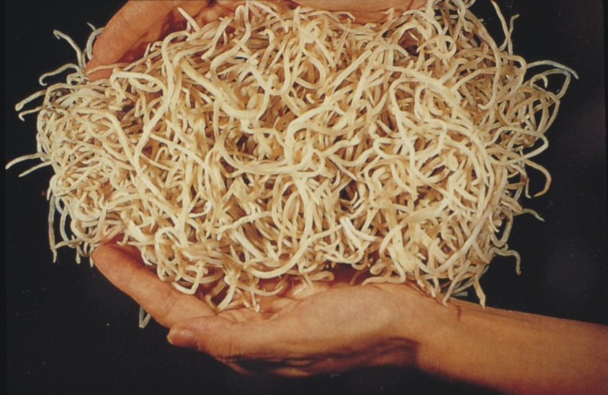
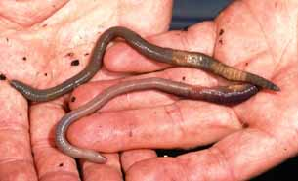
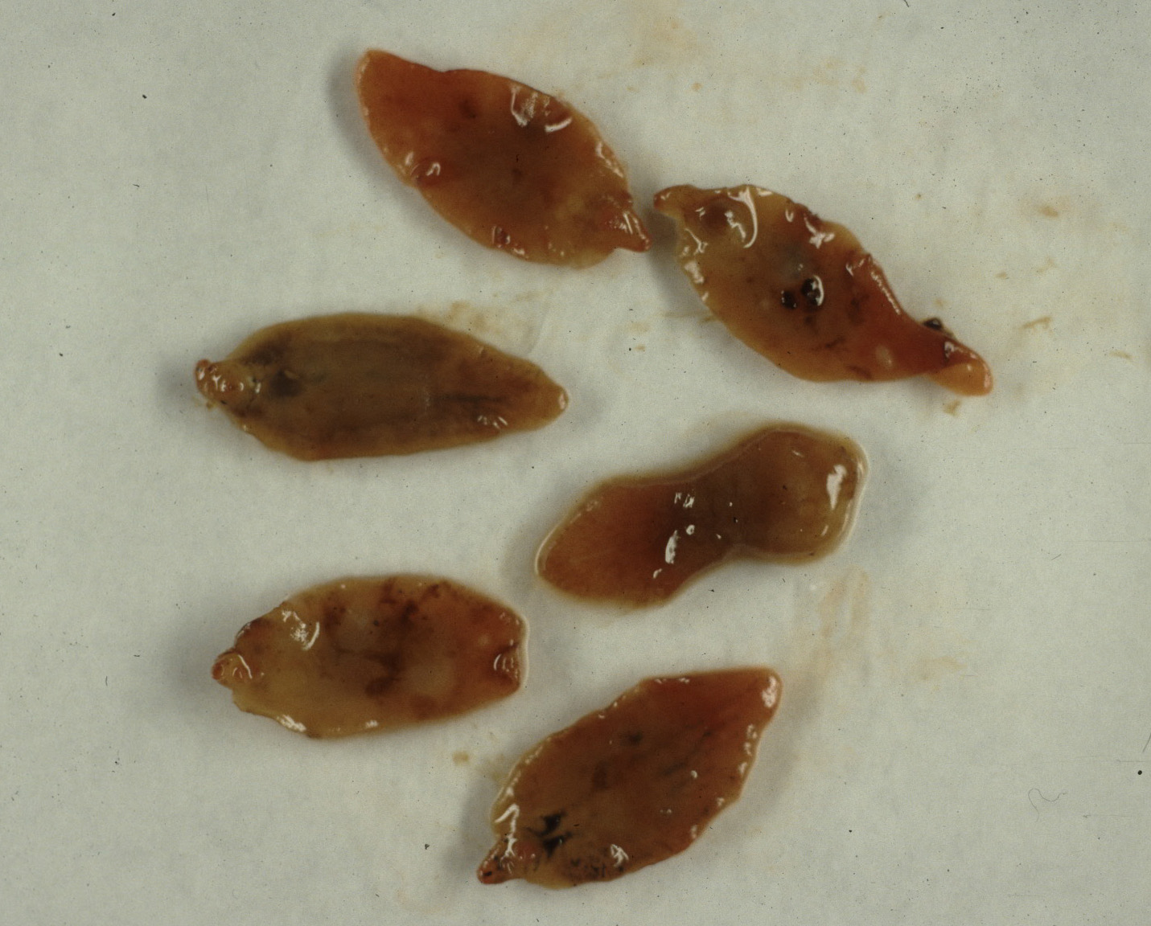
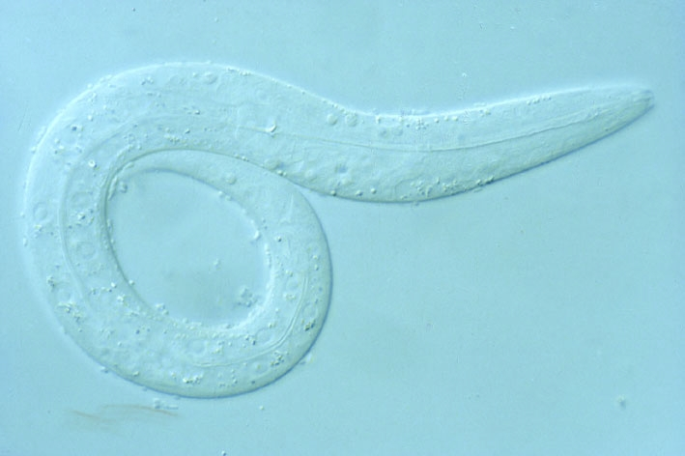
What are worms ???
Ascaris lumbricoides
Lumbricus terrestris
Fasciola hepatica
Caenorhabditis elegans

Slide 3
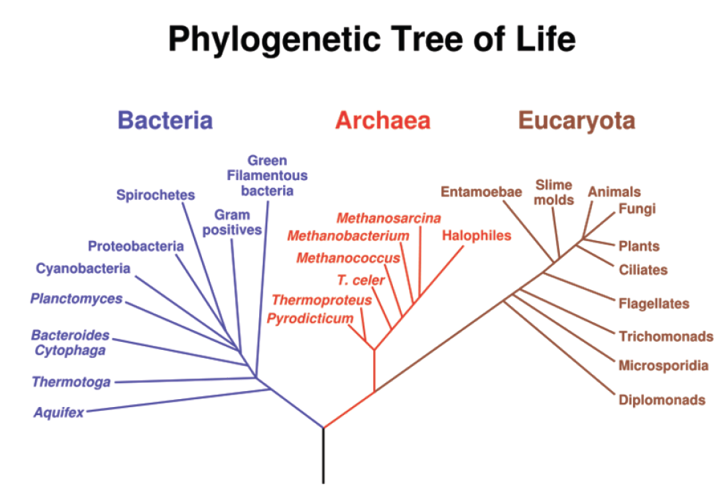
The phylogenetic tree of life
Classification of the living beings
prokaryotes
eukaryotes

Slide 4
WHO estimate the prevalence of some helminths (2015)
Ascaris lumbricoides 807 to 1.121 Million
hookworms604-795 Million
Trichuris trichuria576-740 Million
Schistosoma spp,250Million
Strongyloides stercoralis100 million
geohelminths
At least 2BillionPeople withat least one geohelminthenhe infected,30%theWorld population!
18.05.2018: 7,611billion,
Notes:
Nach dem 2. WK waren 1/3 der Bec. Von Amerika und Europa mit Würmern infiziert!

Slide 5
Helminths and their associated diseases
nematodes
Ascaris lumbricoides
Enterobius vermicularis
Trichinella spiralis
Ancylostoma doudenale/necatorat the.
filaria(Onchocerca Volvo.,Loa loa.wuchereria bancrofti)
Cestoden
Echinococcus spp,
Taenia spp,
trematodes
Schistosoma spp,
Fasciola hepatica
fasciolopsis buski
Clonorchis sinensis
Paragonimus westermanii
round
worms
roundworm
pinworm
trichinosis
hookworm
river blindness.loiasis, Elephantiasis
Cystic and alveolar
Echinococcosis (fox and dog tapeworm)
Pork and beef tapeworm
Flat-
worms
bilharzia
Big liver fluke
Great intestinal gel
Cat liver fluke
lung flukes

Slide 6
cestodes(Tapeworms)
Taenia
•T.saginata.Beef tapeworm
T,saginata asiatica
•T.solium, Pig finned tapeworm
Echinococcus
•E.granulosus, Dog tapeworm
•E.multilocularis, Fox tapeworm
Diphyllobothrium
•D.latum, Fish tapeworm

Slide 7
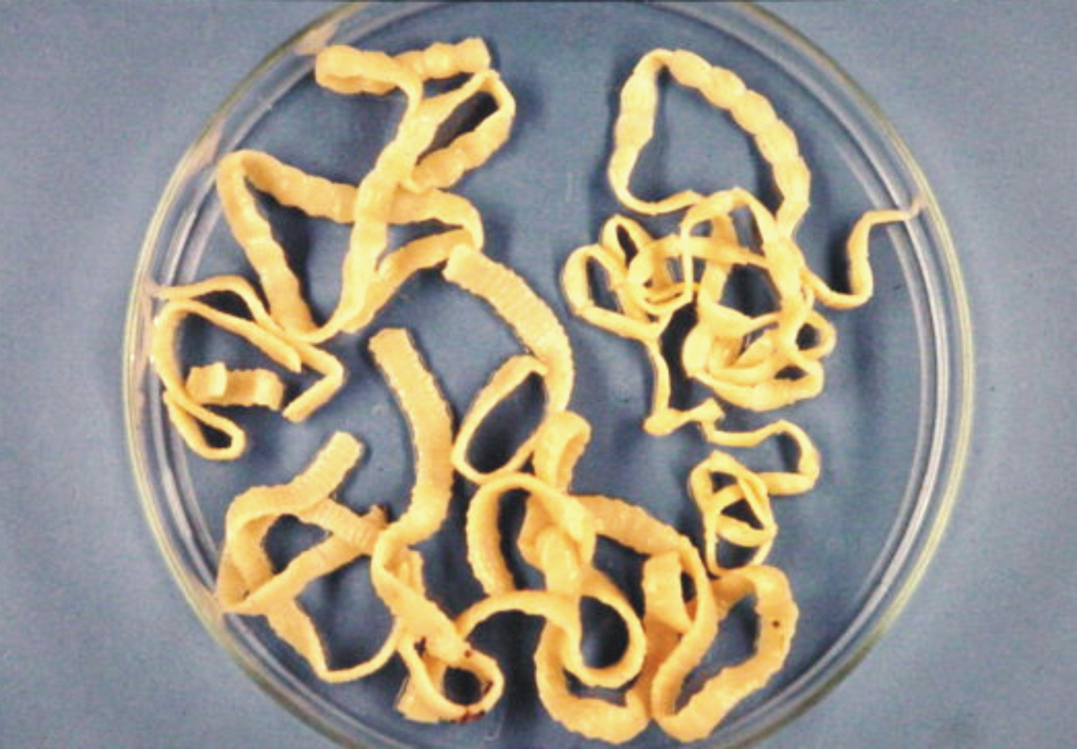

Slide 8
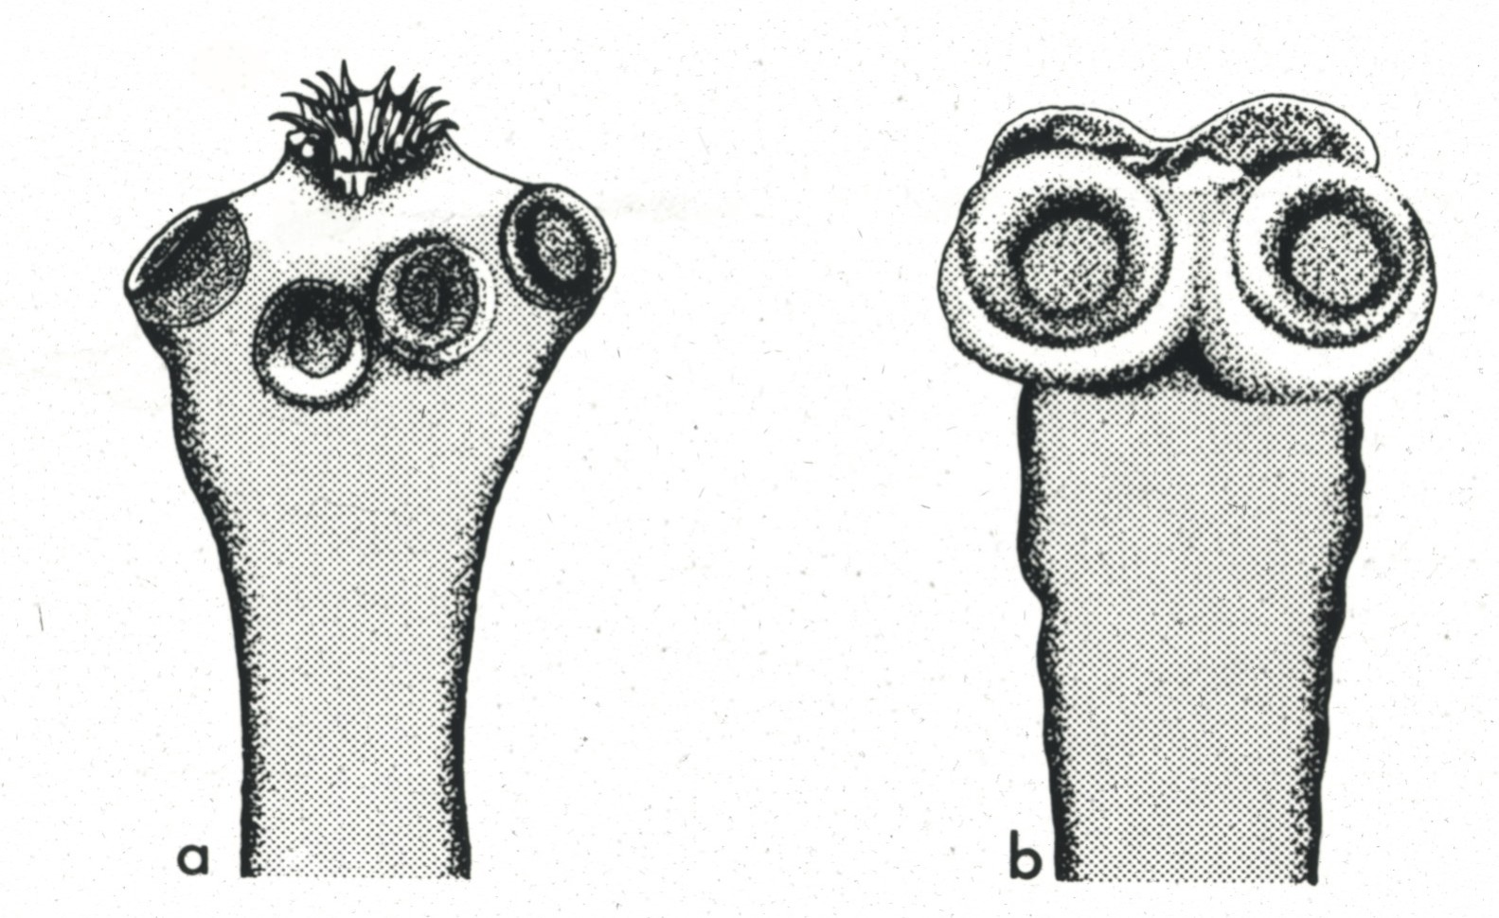
T. solium T. saginata

Slide 9
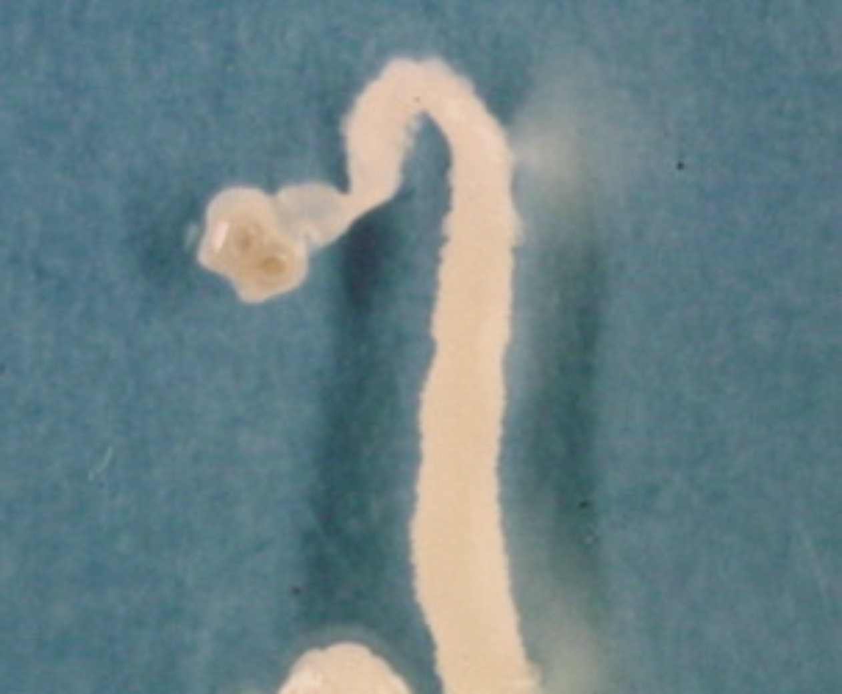

Slide 10
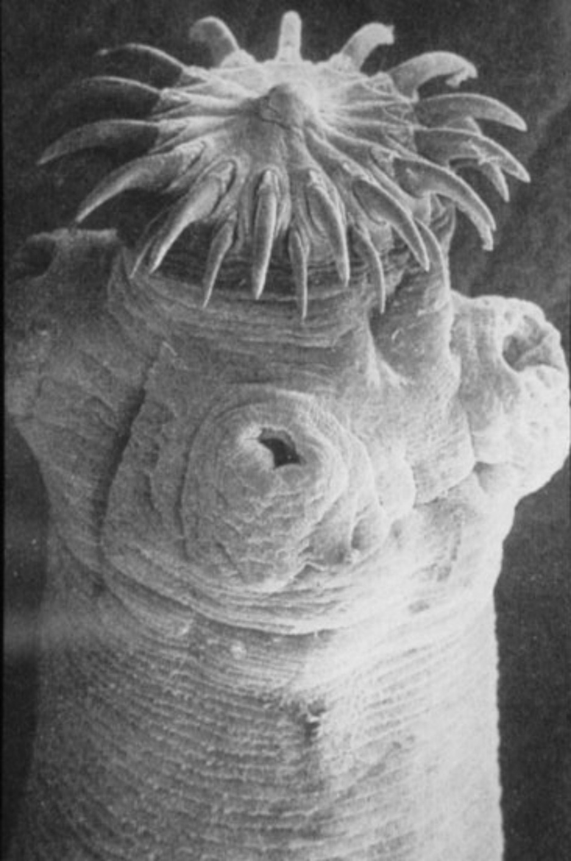

Slide 11
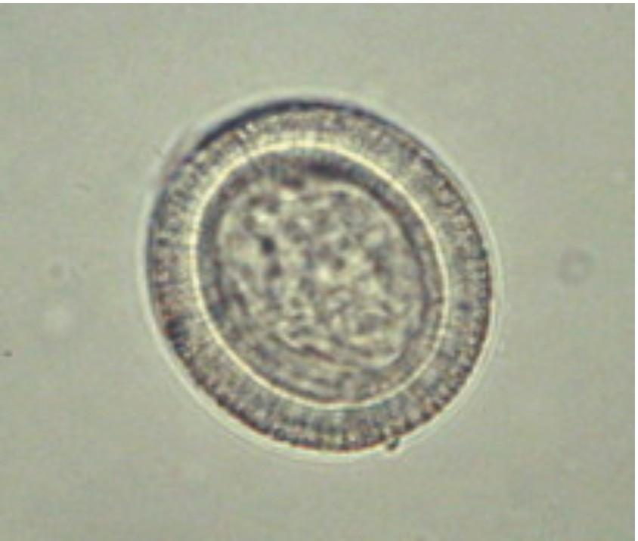
Egg,T.saginata/solium
30-40 μM diameter

Slide 12
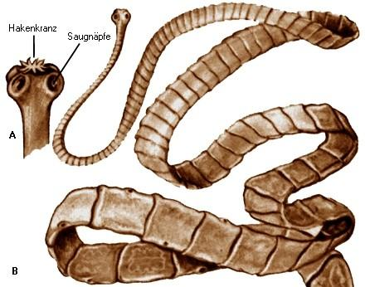
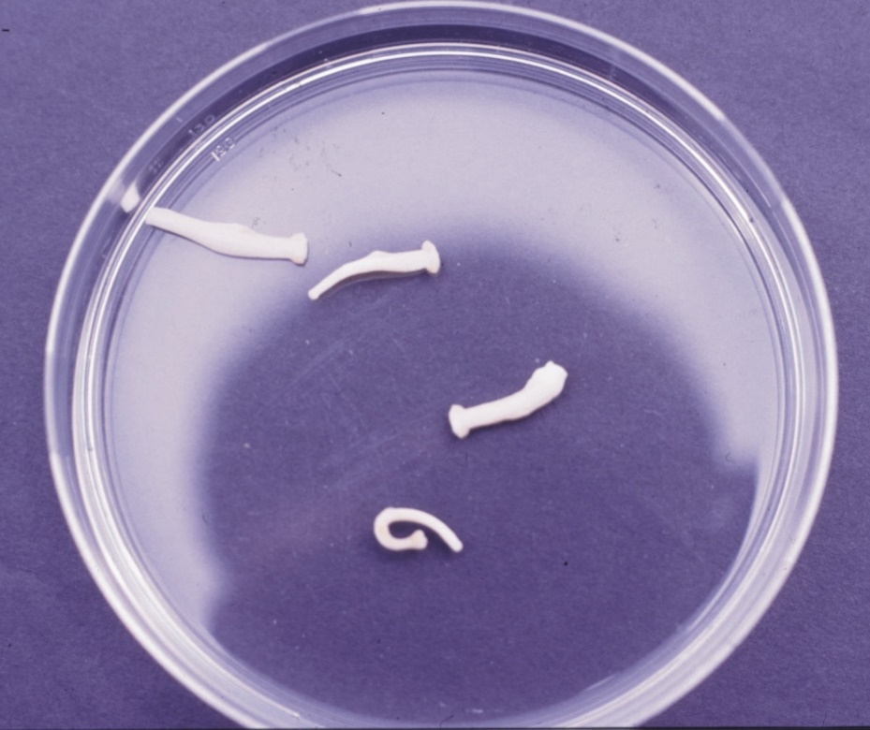

Slide 13
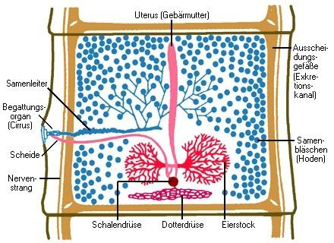
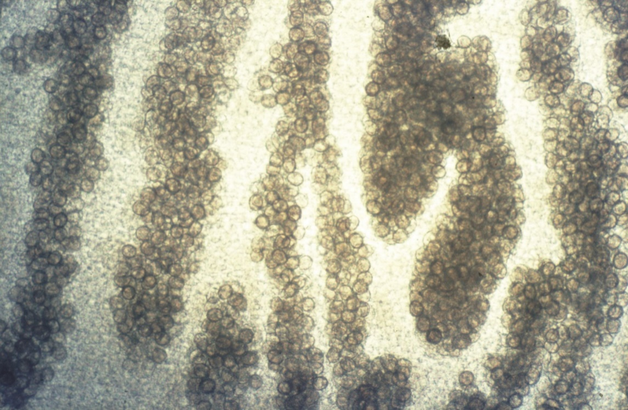
Uterus,T.saginata

Slide 14
Spreading cysticercosis

Slide 15
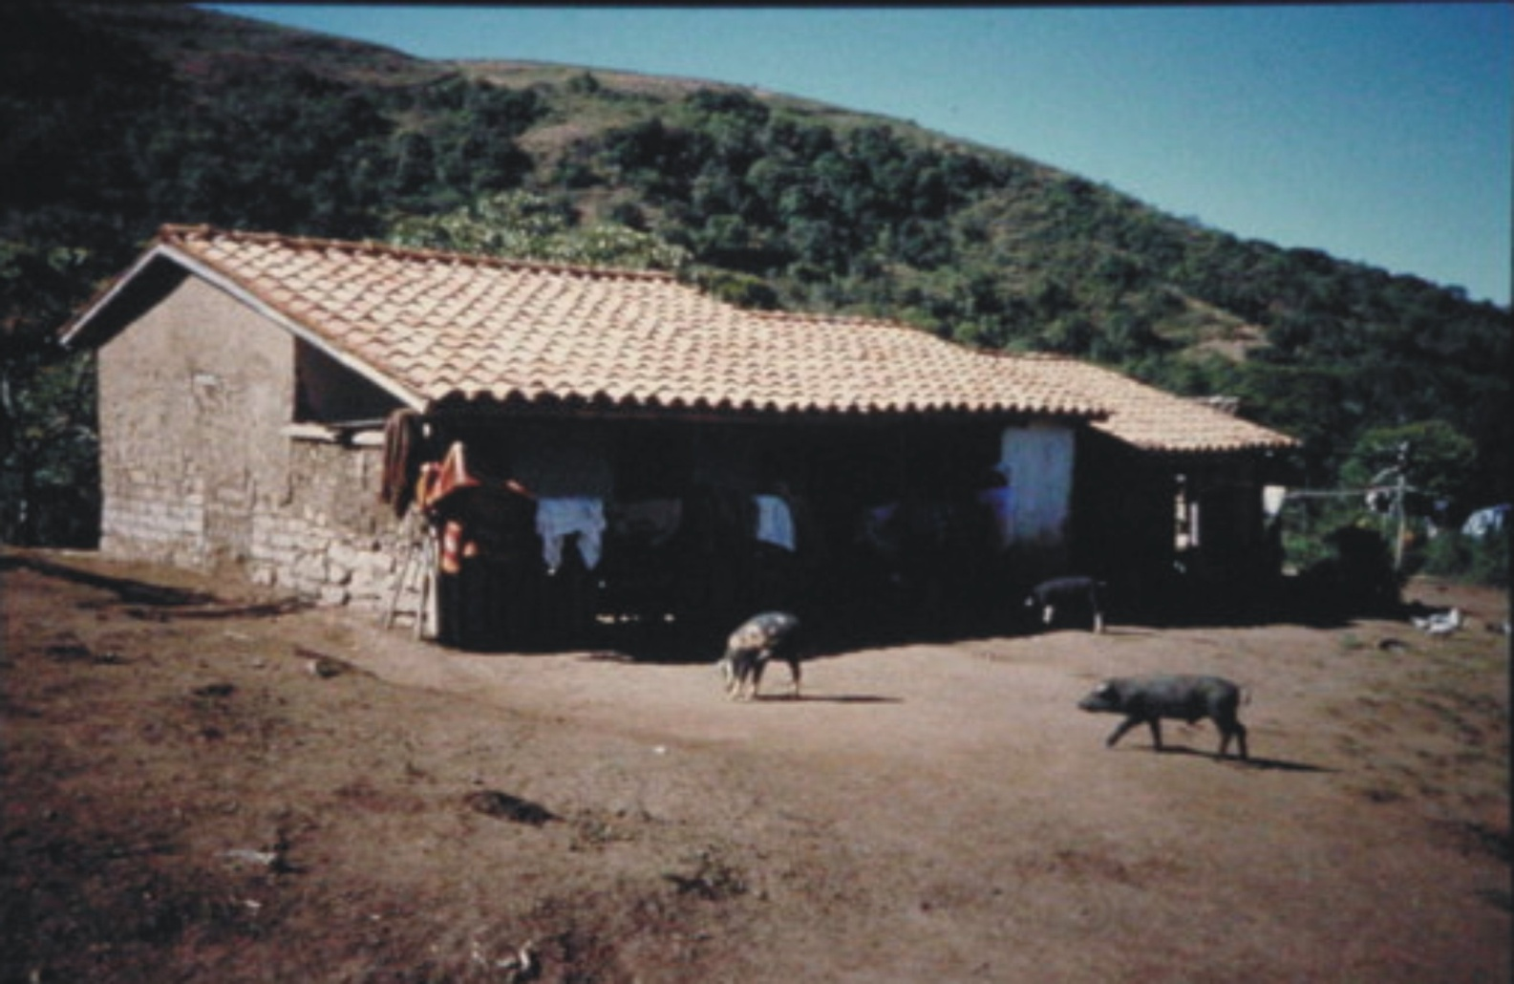
Rural areas of Mexico:7% of people carry tapeworms
25% of pigs carry Finns
Zimbabwe: 12% of people positive in the ELISA

Slide 16
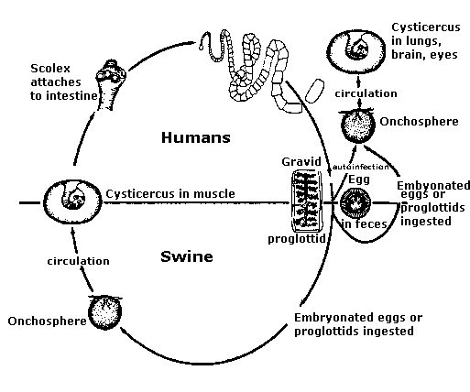
Life cycle ofTaenia solium
Autoinfection!

Slide 17
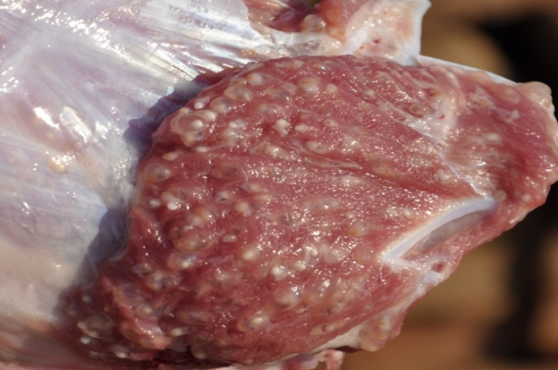
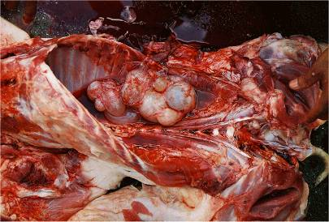
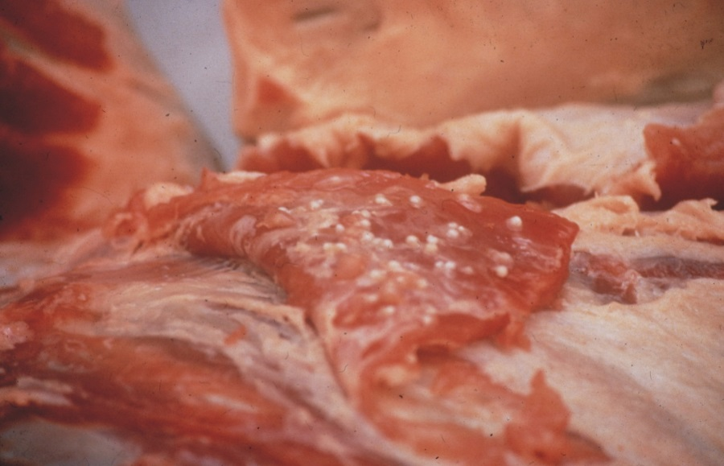
cysticercosis
Infection with the larvae (= fins) of the pork tapeworm

Slide 18
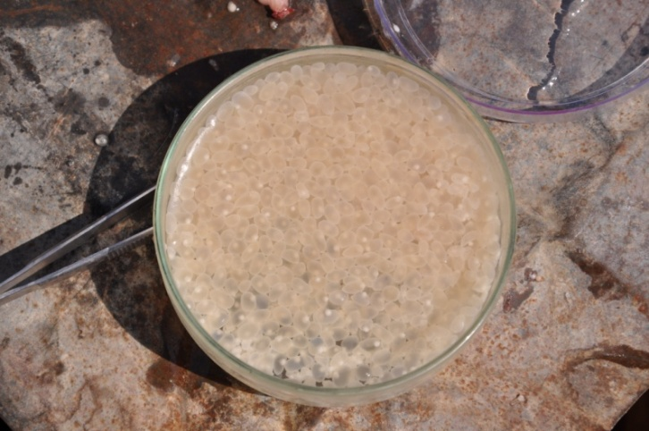
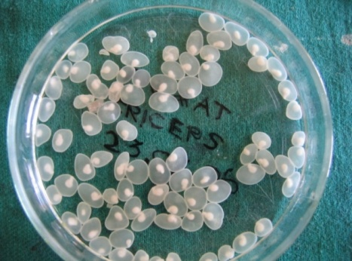
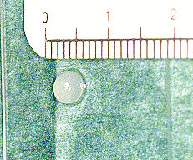
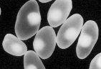
FinnsfromT.solium(cysticercus cellulosce)

Slide 19
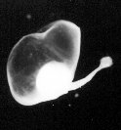

Slide 20
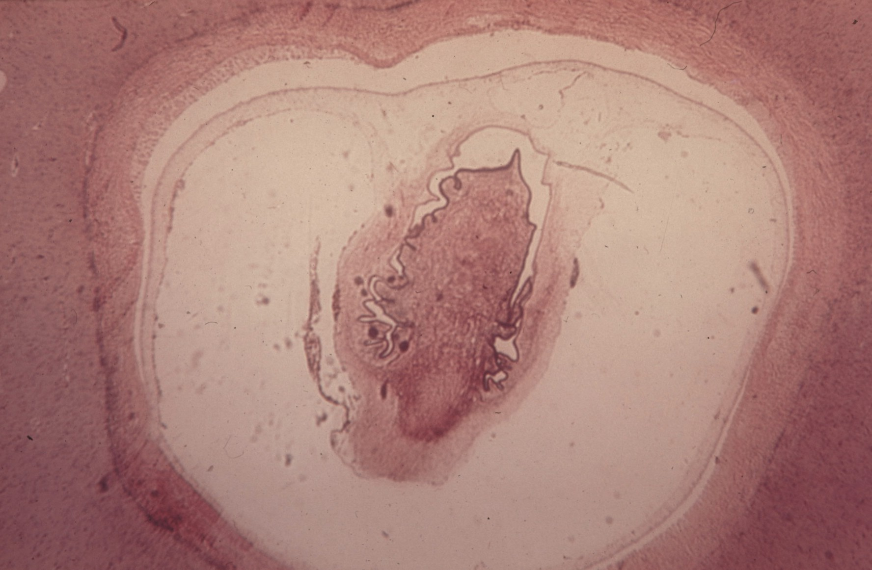

Slide 21

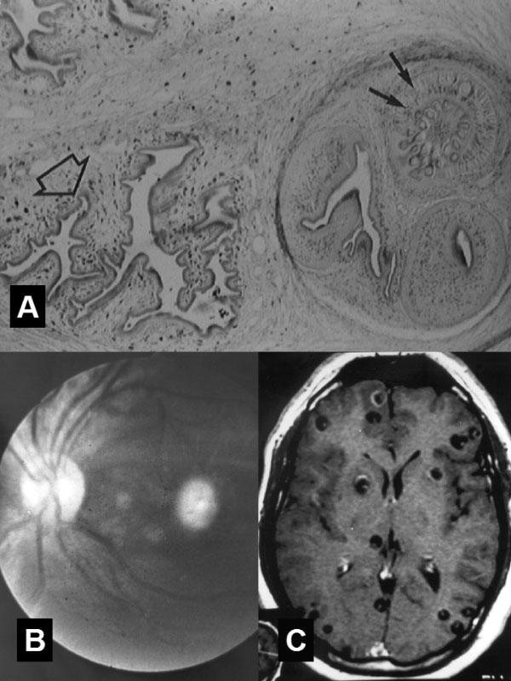
The clinic ofcysticercosis
• By recording T.solium-wobble(not from larvae)
•Oncosphereenters tissue, especially in subcutis,
muscleand CNS
•cysticerciare about 1 cm tall
clinic
Subcutaneous
Only cosmetic
muscle
Sometimes muscle aches
ocular
Scotoma, vision loss

Slide 22
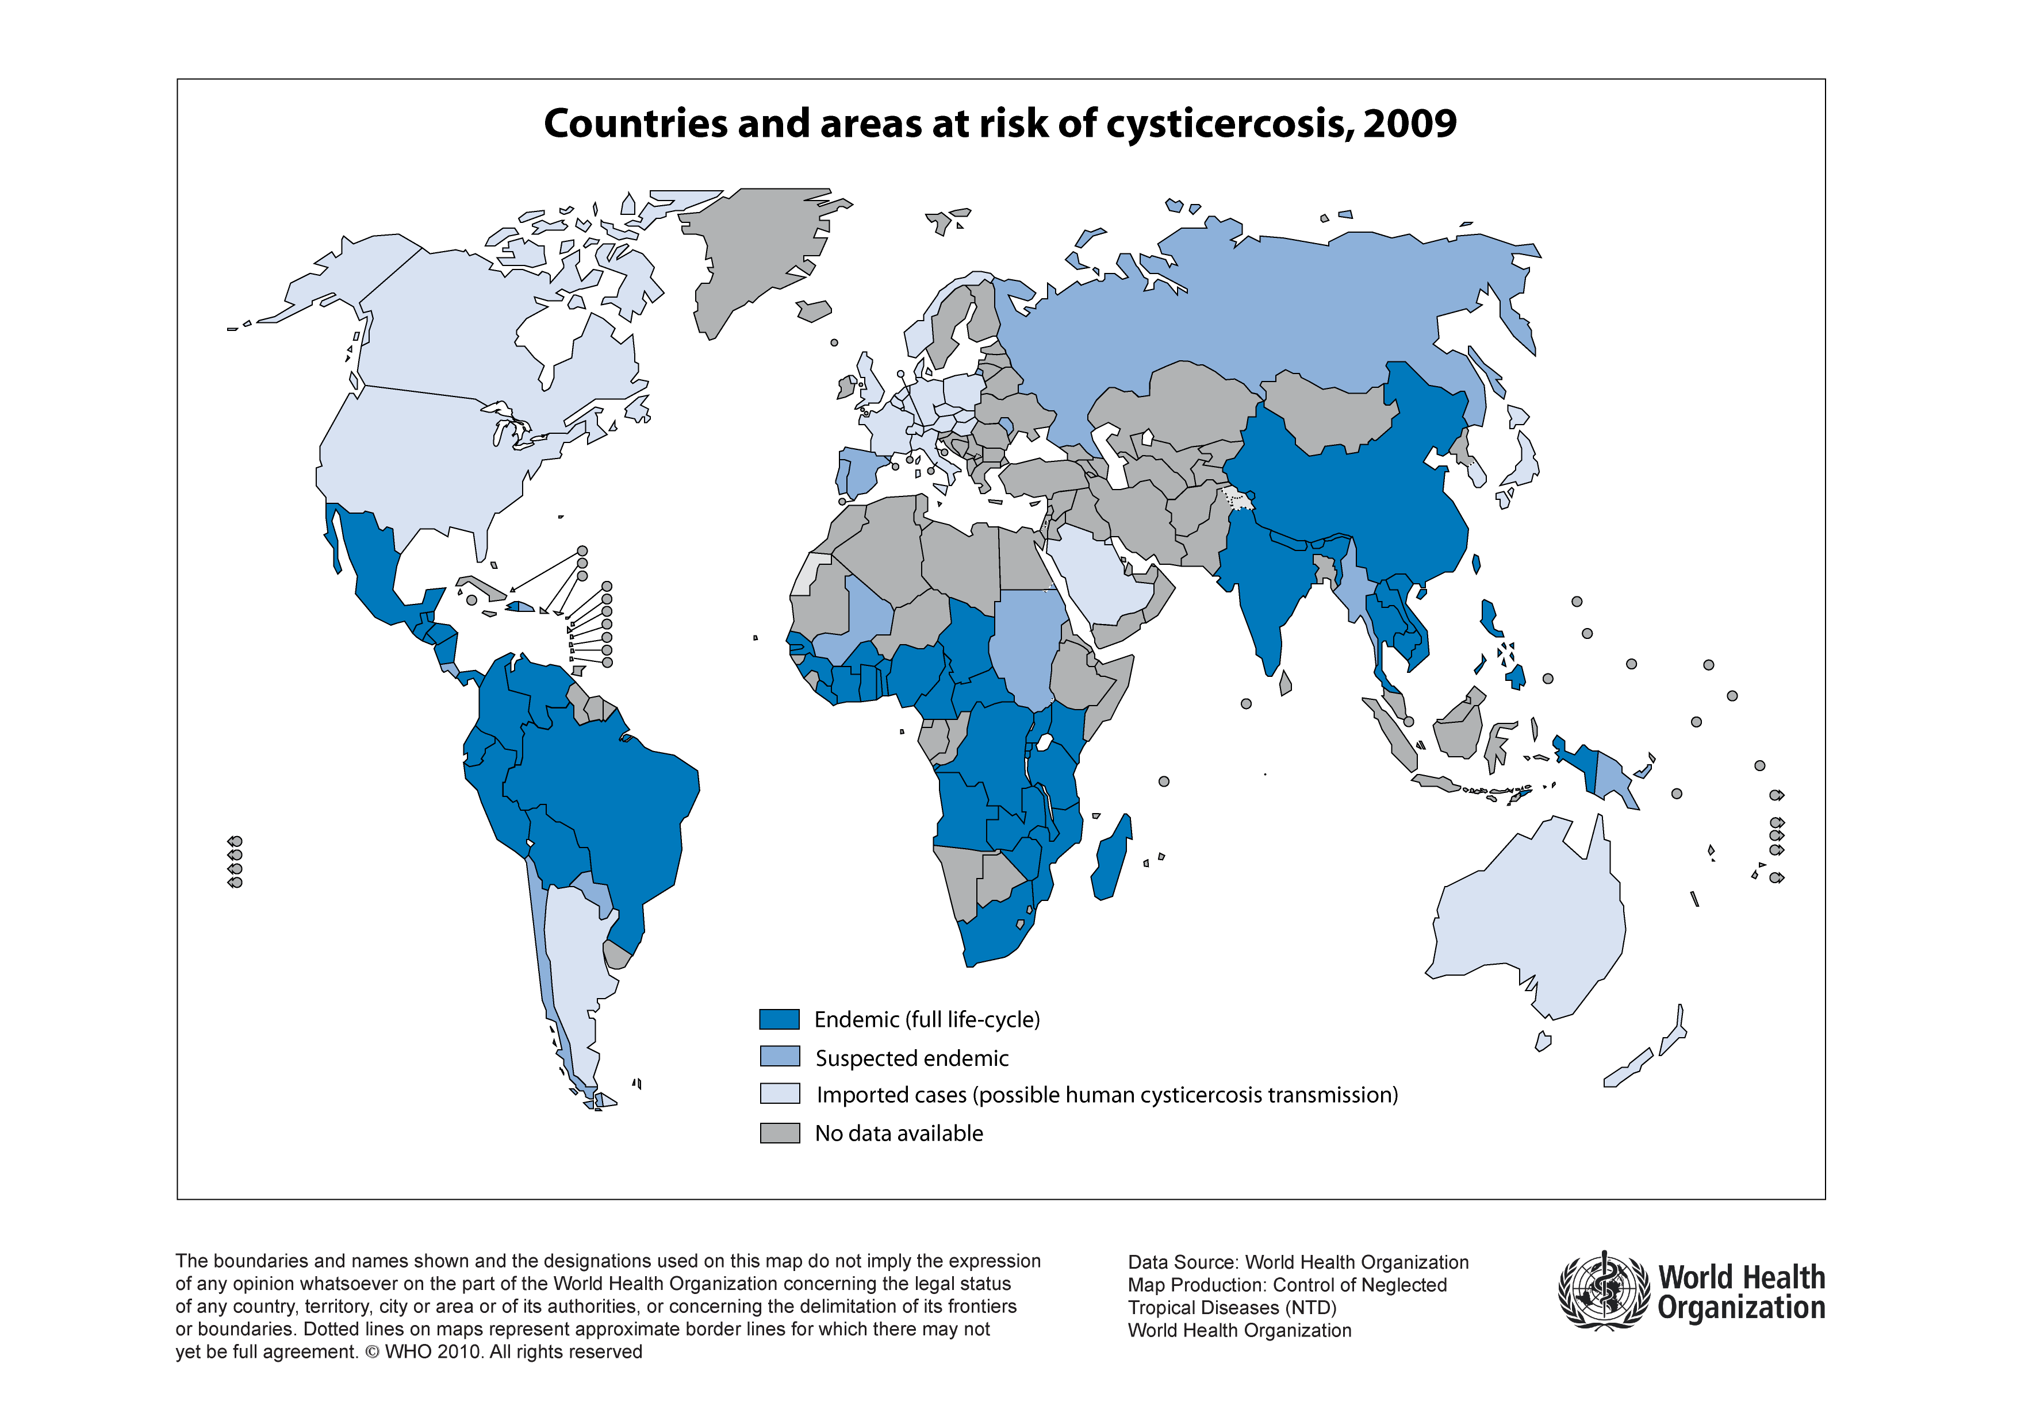
Prevalence of NCC
????
????
5-6 million NCC
Notes:
Up to six miilion people form endemic countries in Africa may suffer form epilepsy. The numbers in Latin America and Asia are less clear!

Slide 23
Clinic ofneurocysticercosis
Clinic (only 10-40% symptomatic):
Epileptic seizures
epilepsy
Headache (and other intracranial marks)
Fokalneurologie
learning difficulties
Psychiatric symptoms
Spinal Cord Syndrome

Slide 24
Pathology ofneurocysticercosis
Active (cysts, granulomas)
Inactive (calcifications)
parenchymalNCC
ExtraparenchymatöseNCC (ventricle,Subarachnoidalraum)

Slide 25
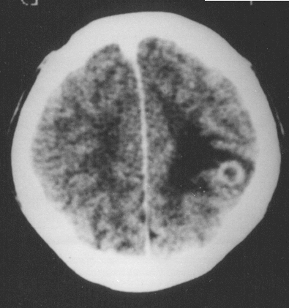
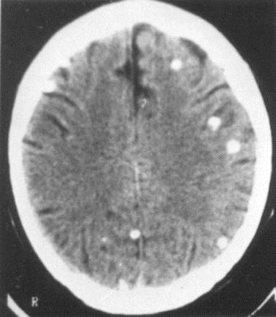
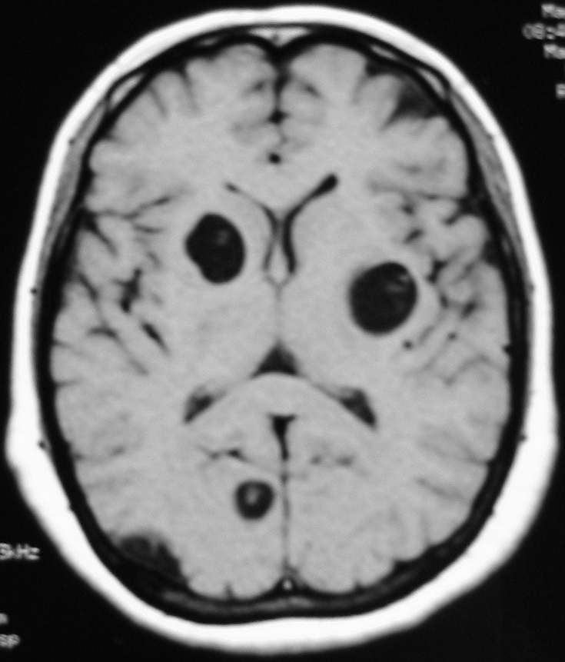
Radiology ofneurocysticercosis
Determination of the activity level of the inflammatory reaction
cyst →
granuloma →
calcification
Disappearance of the lesions

Slide 26
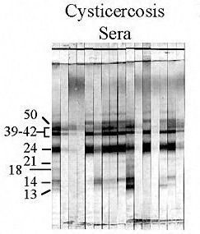
diagnostics
Clinic, imaging: CCT, NMR
immunoblot: Gold standard for the detection of antibodies
Sensitivity 98% and specificity 100% when using sevencysticercusspecificglycoproteins

Slide 27
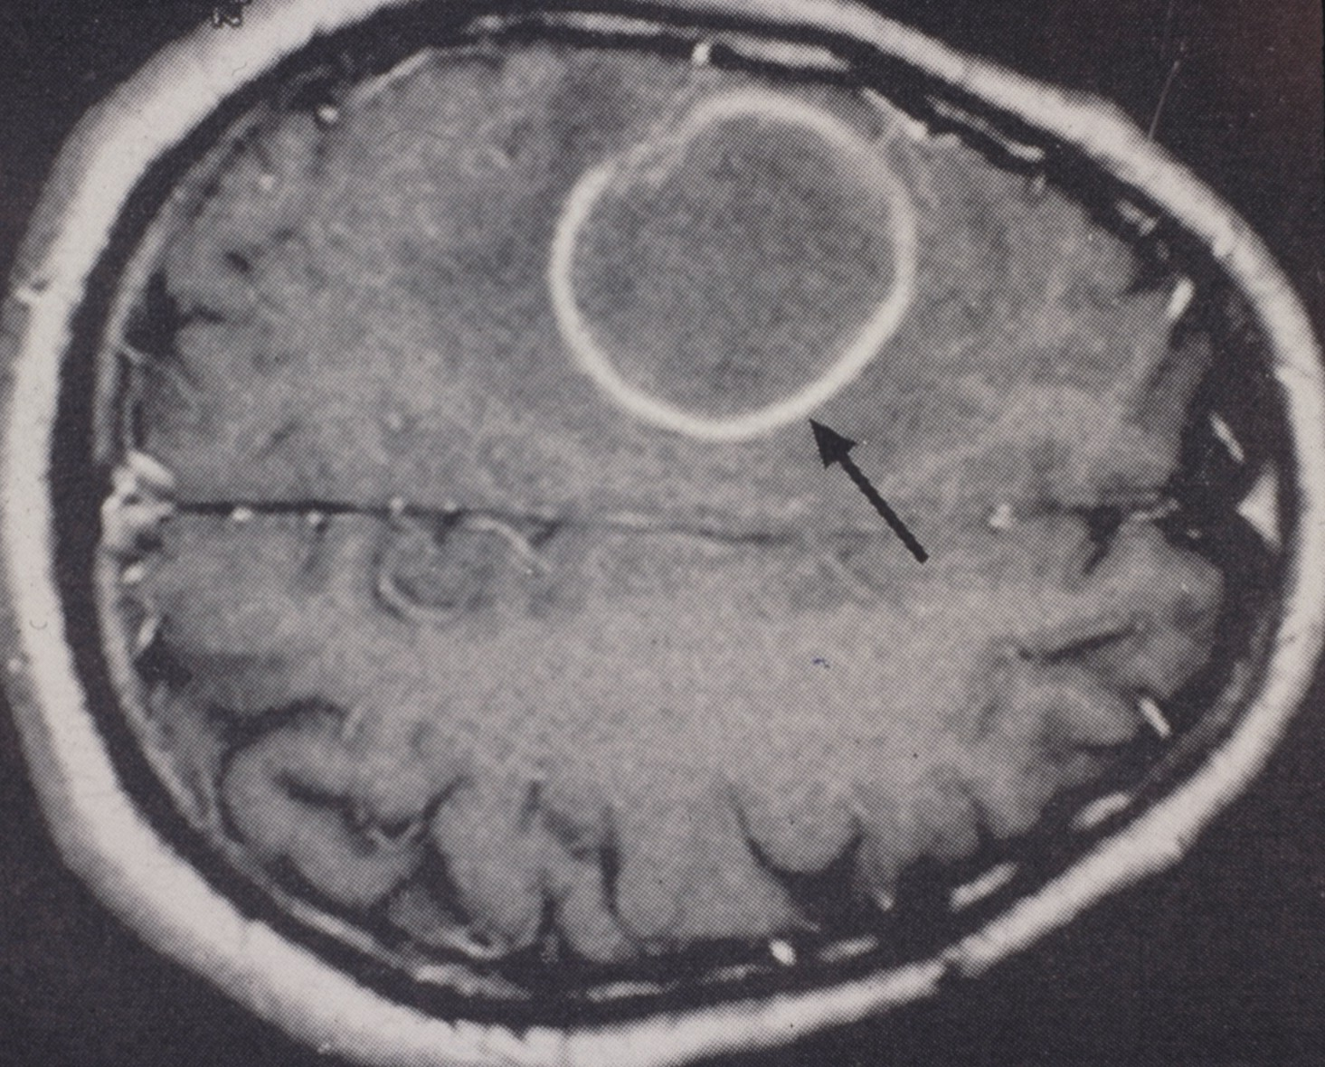

Slide 28
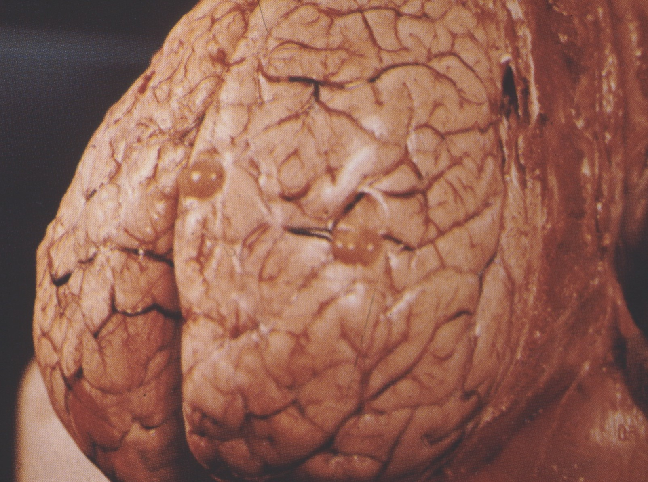

Slide 29
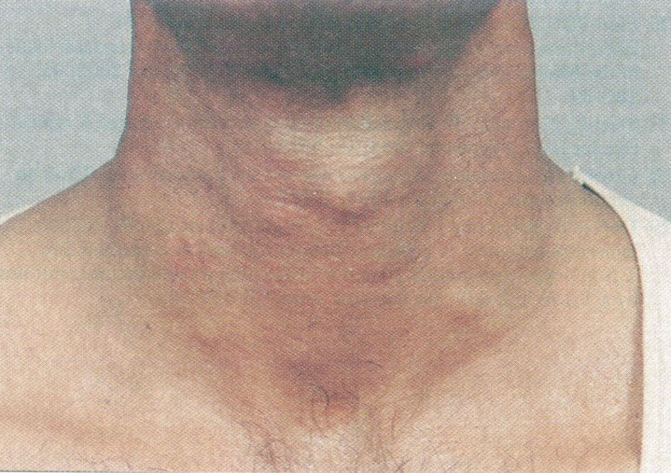
Skin and skinneurocysticercosis (Case Report Lancet, 2004:35 years
Indian farmer withsevere psychotic changes)

Slide 30
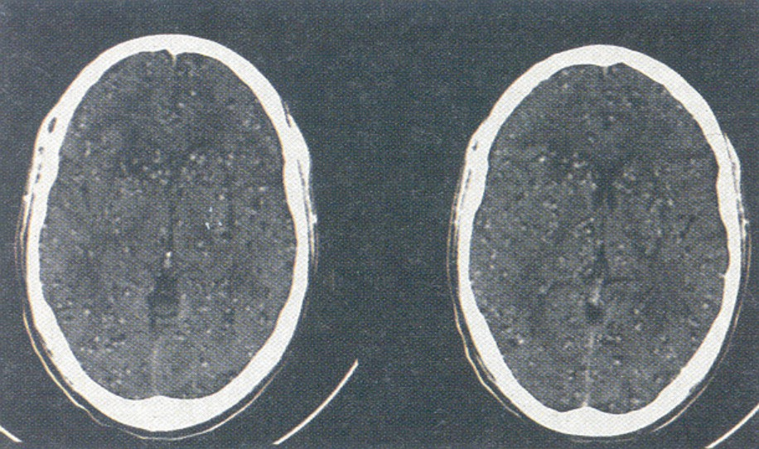
disseminatedneurocysticercosis(Case Report Lancet, 2004)
albendazole/ Cortisone for 28 days, almost completely cured

Slide 31
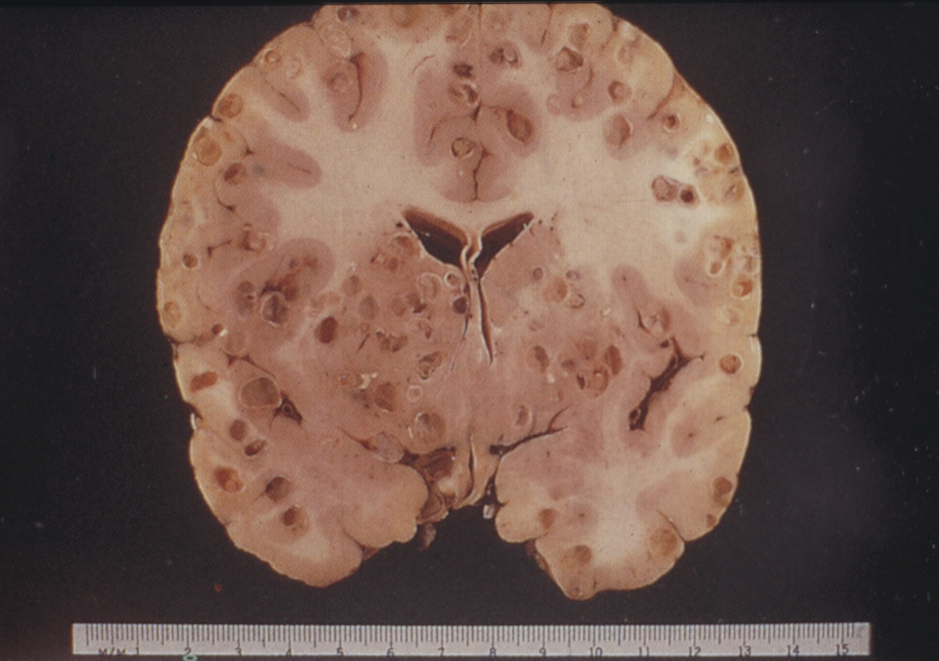

Slide 32
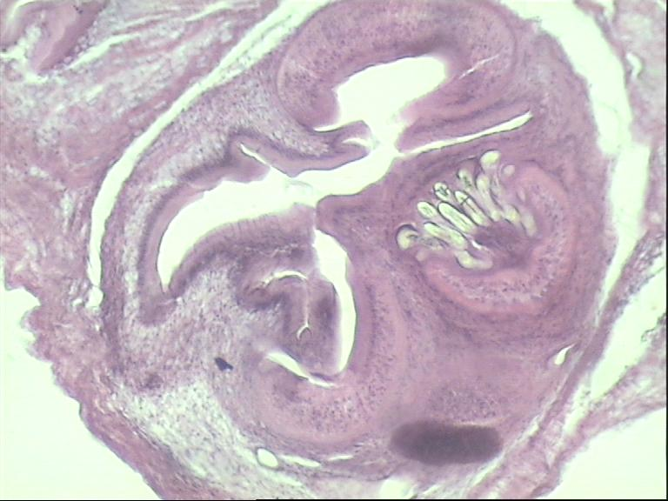
Skin node, right breast, 24-year-old. Patient from Cambodia

Slide 33
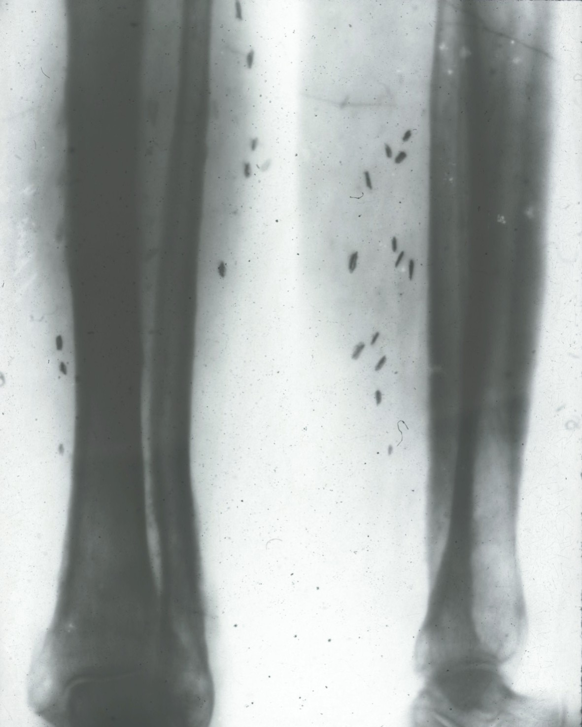

Slide 34
therapy
• Not required for skin / (rarely) muscle infections / calcified cysts
• Probably not required for neurocysticercosis in children
• praziquantel / albendazole steroids (allergic reactions)
• Neurosurgery

Slide 35
control measures
•Education: controlled slaughter, meat inspection
Cookof the meat
• Disposal of humanfaeces
• Chemotherapy (albendazole.praziquantel+/- cortisone)

Slide 36
Clinical case from theRDI
Anamnesis 2011
40 years old patient, from Brazil
sincemany years in Europe (Italy-Germany)
Finding words
Memory and concentration weakness
A mild headache
Confused before recording for 3 days
Instruction Klinikum Schwabing
Neurologically unremarkable
First epileptic seizure

Slide 37
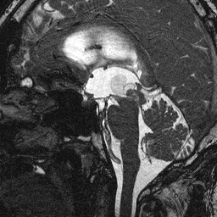
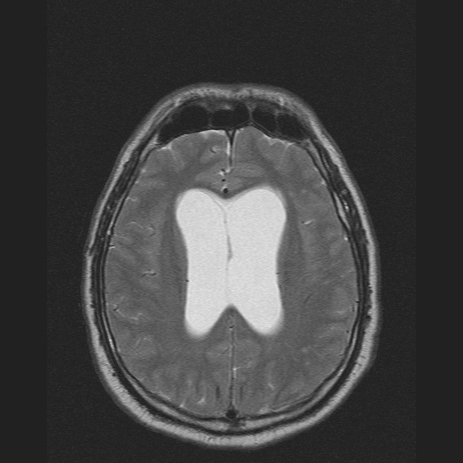
Cerebral findings: blisteredzystiscchemass
MRI (T2) 28.06.2011:Mass 3. Ventricle, hydrocephalusocclusus

Slide 38
Further course in 2011
Diagnosis: hydrocephalusinternusunclear genesis
In MRI suspected tumorous process egependymomaat theAquädukteingang; no longer detectable during surgery (!!!)
Therapy:ventriculostomyof the 3rd ventricle in thepräpontinecistern
BUT:February 2013: persistent concentration disorder; Presentation Neurosurgery TUM

Slide 39
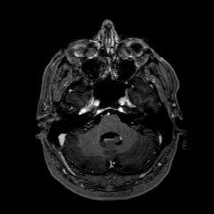
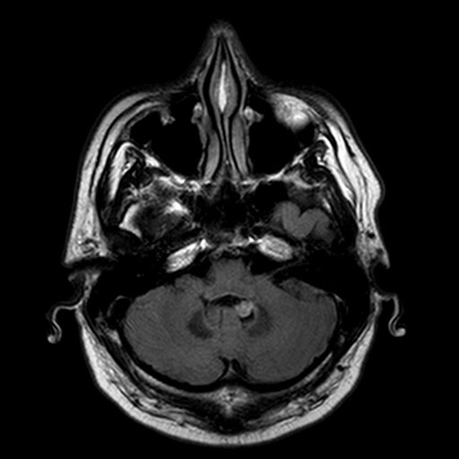
MRT (T1) 25.02.2013Cyst in the 4th ventricle
MRI (T1) 25.02.13KM receiving mass at the bottom of the 4 ventricle

Slide 40
Further course in 2013
Suboccipital trepanation and removal of the mass
Histology: racemic cyst
CSF: 39 cells /ul.eosinophilia
Serology (via CDC Atlanta):
LLGP-EITBandRT24-Westernin serum and CSF positive,
rES33: detectedtaeniasiswasnegative in the serum,
Antigen ELISAin serum positiveandin the liquornegative
serology(University of Bonn):
cysticercosis immunoblotpositive in the cerebrospinal fluidand in serum
borderline
Diagnosis:neurocysticercosis(NCC)

Slide 41
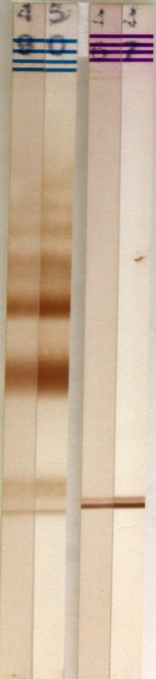
diagnostics
EITB serum
rT24 / rES33 blot serum
EITB liquor
rT24 blot liquor
Notes:
Nur als kleine Ergänzung: Ich hänge ein Bild von den Streifen der durchgeführten in-house Blots an (von links nach rechts) 1: LLGP EITB Serum 2:LLGP EITB Liquor 3: rT24/rES33-blot Serum 4:rT24 blot Liquor Alles bis auf die rES33-Bande (sollte bei 3 ca. 1 cm über der rT24 Bande erscheinen) positiv. Das heißt, CC Ab positiv in allen Tests, aber keine Taeniasis Abs.

Slide 42
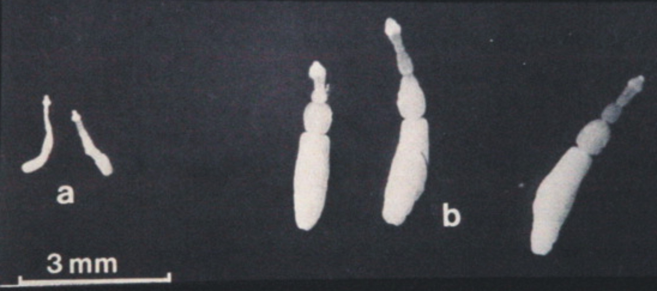
echinococci
E. multilocularis E. granulosus

Slide 43
E.granulosus(Dog tapeworm):
Pathogen of thecystic echinococcosis
E.multilocularis(Fox tapeworm):
Pathogen of thealveolar echinococcosis

Slide 44
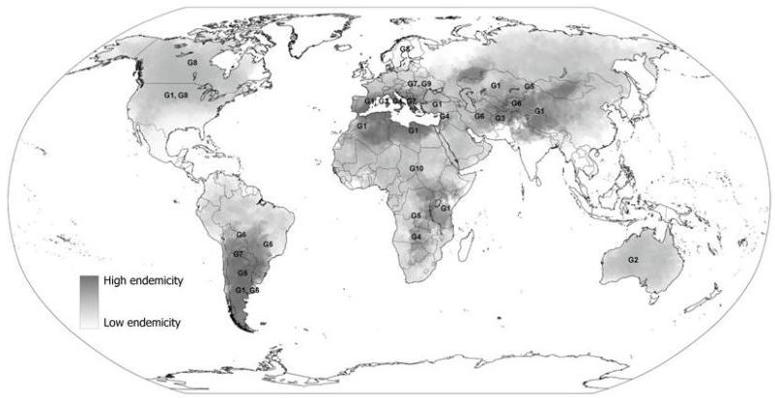
Worldwide distribution of E.granulosus

Slide 45
Dog tapeworm
Echinococcus granulosus
Endwirt: adult worms
Intermediate host: larval stages
Fehlwirt: dead end
Endwirt: Dog (Wolf, Dingo, Jackal)
intermediate host: Sheep (pig, horse, camel)
accidental host: Human

Slide 46

E. granulosus
• Main distribution Central and South America, Mediterranean countries, Middle East,
Africa, Russia, China
• Annual incidence (data published in 1996, per 100 000)
Greece 13
Argentina (some provinces) 143
Hinjang/ China 197
Turkana/ Kenya 220

Slide 47
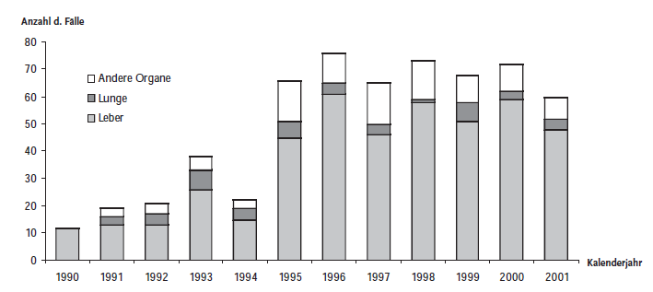
Incidence E. granulosus (human infections)
Germany: practically eradicated (onlyimported cases, see below)
Mediterranean: 1 - 10/100 000
South America, Asia: 40 - 50/100 000
Source: RKI, Epidemiological Bulletin 38/05

Slide 48
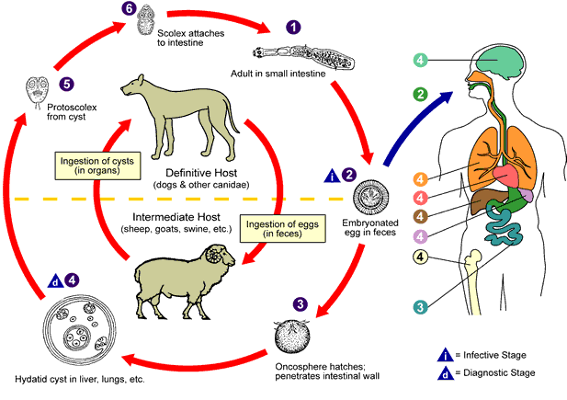

Slide 49
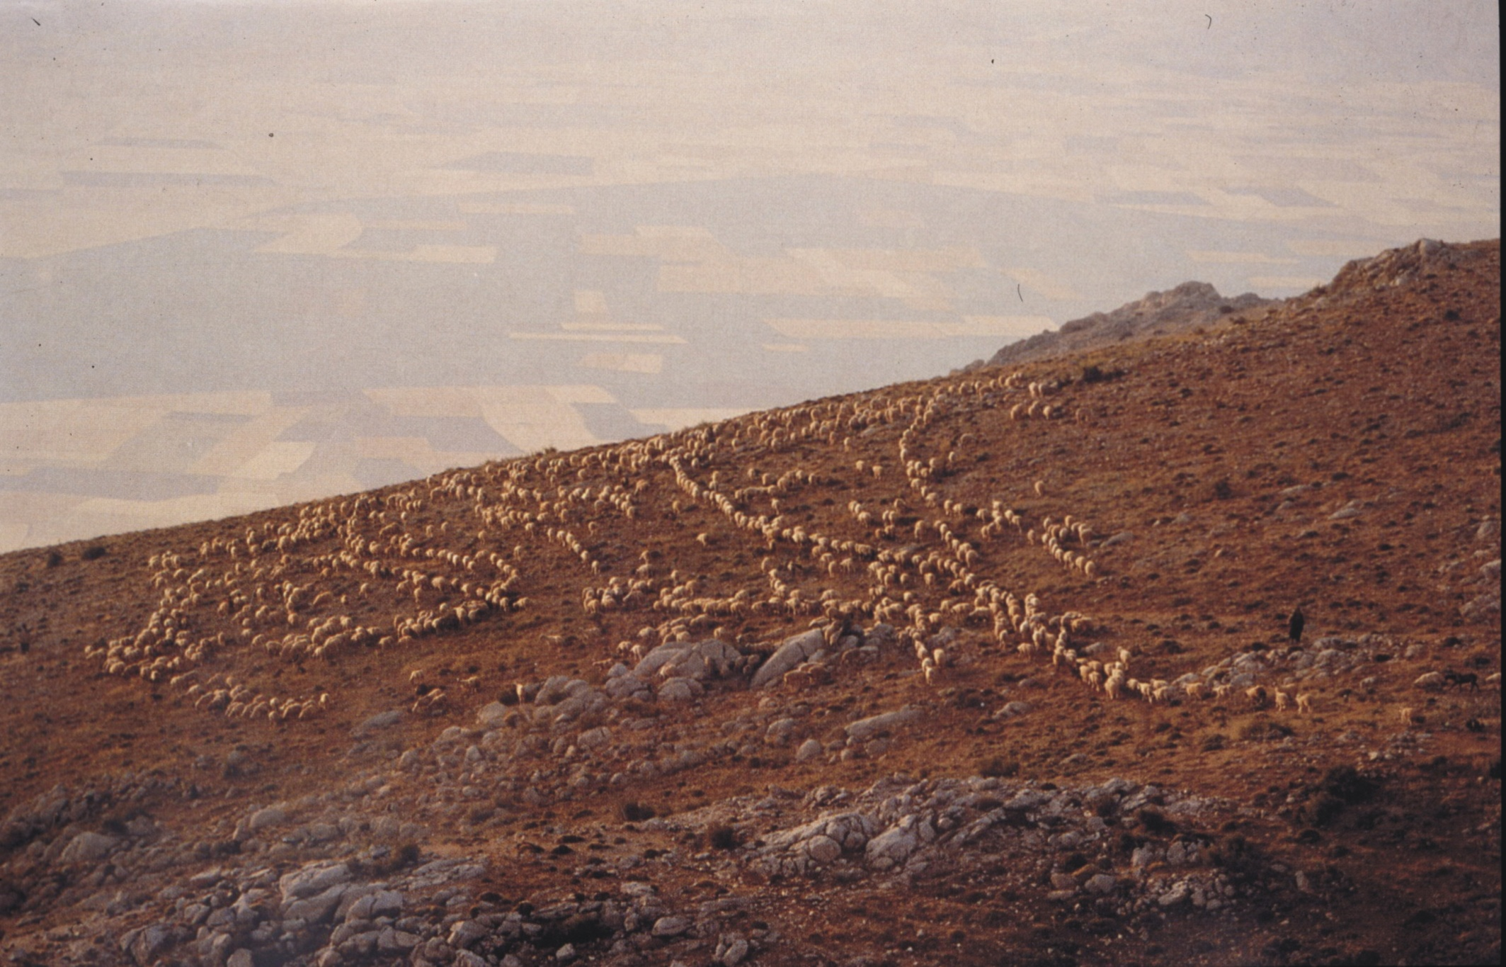

Slide 50


Slide 51


Slide 52


Slide 53

Adult worms in the small intestine of a dog

Slide 54


Slide 55

E.granulosus, adult worm

Slide 56

About 1500 eggs,lifetime6 months

Slide 57


Slide 58


Slide 59


Slide 60

Organ distribution ofE.granulosusCysts in humans

Slide 61
diagnostics
• Clinic: repressive effects depending on the location
•Sonography / Histology
• SerologicalMethods: ELISA with larval antigen or
recombinant proteins
•PCR as the most accurate / sensitive species determination

Slide 62

hydatid cystin humans
Fin,Metacestode

Slide 63


Slide 64


Slide 65

indirectImmunofluorescence: serum

Slide 66


Slide 67


Slide 68


Slide 69


Slide 70


Slide 71

&quot;Hydatidensand&quot;

Slide 72

Patient, Turkey

Slide 73


Slide 74


Slide 75


Slide 76


Slide 77
therapy
• No symptoms: wait?
• Radical operation, if possible (operable in 50-85% of cases)
• PAIR (Puncture, Aspiration,Injection of helminthicide.Reaspiration)
• chemotherapy (regression in 50 - 100% of cases)
(mebendazole/albendazole.praziquantel)

Slide 78
The clinical case and his brothers ....
Case 1:22-year-old patient; Abdominal pain; CT: 13x16cm liver cyst
Withaccentuated wall on;seronegativ for amoebae and echinococciVa, on adysontogeneticCyst and openpericystectomy; intraoperative,microscopicproof ofSkolizesin thecyst secretion; Diagnosis: cystichydatid disease(CE);Albendazoltherapie andseroconversion(!)Größenprogredienz; 96%Ethanol injection(PAIR); after 12 months underalbendazoleTherapy: significant size decrease .... and then came ......
Case 2:25-year-old brother with 12x11cm cystic liver space requirement (WHO CE1); this timepositiveE.granulosus-Serologyaccording to WHO recommendationsalbendazole and 2xPAIR therapy. VitaleSkolizesin the cyst secretion; currently size constantWHOCE3 cyst ofLiver ... .and then came ...
Case 3:17-year-old brother; symptom-free before;sonographically 3 CE1 cysts in theliveras well as a pulmonary CE1 cyst;positiveE.granulosus-serology;albendazole; nonePAIR not at first, but after spontaneousrupturethe pulmonary cyst with connection to the bronchial system: atypicallung segment
partial resection left with cystectomy; PAIR of the largest cystplanned ... and then ... ???
Notes:
Nicht Thomas Mann Joseph und seine Brüder….

Slide 79



initialsonographicand microscopic findings

Slide 80

The PAIR as a therapeutic approach
PAIR =Puncture.Aspiration,Iinjection of
Helminthizidenor ethanol.Reaspiration
19G -Puncture needleabout the
theCyst contents already largely
emptiedwas, and at one
microscopicproof of
Skolizes pure ethanol is instilled
(see wise area between the
Liquid residues!)

Slide 81


sonographiccourse
1 day after PAIR 8 months after PAIR
Thecollapsed cyst wall
isunchanged fromecho-
lowSurrounded liquid,
theCyst wall is (still)
Notcalcified, but in the cp.
much narrower.
Notes:
Sonographsiche Darstellung
der Zyste im WHO-Stadium
CE3 nach 2x PAIR-Therapie.
Die kollabierte Zystenwand
ist unverändert von echo-
armer Flüssigkeit umgeben,
die Zystenwand ist (noch)
nicht verkalkt, aber im vgl.
deutlich schmaler.

Slide 82


Slide 83


Slide 84


Slide 85


Slide 86


Slide 87
Clinical case onRDI/S2/4
68-year-old patient
No significant pre-existing conditions
In April 2015: sudden jaundice, slight pulling
in the upper abdomen
Dog owner, many walks in the English Garden
and forest
1994 consumption of blueberries
In Istanbulgrew up
Occupation: Journalist, Traveling
Bilirubin 3.1ng/ ml

Slide 88


Abdominal sonography
epigastricSono: RF 4x4cm with calcification solitary slightly diffuse

Slide 89


Slide 90
Serological findings
MIH:E.granulosus ELISAandE.multilocularis positive
Reference Laboratory University of Würzburg / Prof. K. Brehm:
HAS addiction test 1: 320 (E.granulosusAntigen)
E.multiloc, Total larvae ELISA: 6.7 index positive
AntigenB ELISA: 0.3 index negative
Em10 ELISA: 2,3 positive

Slide 91


Prince Regent Streeton 15.5.13 ... ..

Slide 92
Intestinal nematodes (geohelminths)
1. Direct transmission
Eggs are instantinfectious egTrichuris trichuria, Hookworms
2. Direct, but with development time in the environment
To become eggsexcreted egAscaris lumbricoides
3. Larvae infect through the skin
Developmental stages outside theBody egStrogyloides stercoralis

Slide 93
filariasis
definition: Infection withnematodes, byvectorsbe transferred and imtissuelive of the host
Adult worms (=macrofilariae) can be up to20 yearssurvive and divorcemicrofilariaeout in thebloodor in theskinoftenperiodicallycirculate

Slide 94

The general filar cycle
L4
L1
Vulnerable!
L3
L2

Slide 95

Classification of the filaria

Slide 96

Characteristics of the different filarioses:
1) larvaeare
microfilariae:
about 100-300μm
2) Location of the cores:
eg to the end or not
Notes:
MF

Slide 97

3) withcover /sheath
without sheath
Notes:
Tegument als Organ zur Nahrungsresorption

Slide 98

The lymphatic filarioses 128 million infected (va, India and sub-Saharan); Risk population: 750 million
Notes:
Indien: 20Mio. Inf. und 2/3 chirurg. behandlungsbedürftig

Slide 99

Only host: human
Life expectancy:
5-10 years
In the Hilus of the LKN
prepatency-
Phase: 7months
But:&gt; 99%ent-
wmake upNot
to adults !!!
Only 50% of all
infected
Notes:
Ink.: 8-16 Monate oer kürzer

Slide 100


Slide 101

Notes:
Stechrüssel mit MF 60/Stich

Slide 102
Pathogenesis and immunology
(dying) adult worms: ADCC (antibody-dependent cellular cytotoxicity response) witheosinophilsand macrophages
Pathology: necrosis, inflammation, granulomas, giant cells; Worm remainsphagozytiertor calcify
endosymbionts:Wolbachia(Bacteria) stimulate thatinnateImmune system and promote the (lymph)angiogenesis
Or
In themajority theLocals especially in theendemic area: Immunosuppression (regulatory T cells, IgG4 binds worm antigens but without effect)
Notes:
ADCC: NK Zell-FcR (CD16) bindet an AK-AG Komplex, wird cross-gelinkt, Aktivierung der NK Zellen und Freisetzung lyt. Enzyme und Zelltod; ähnl. Bei Eos und FcepsilonR-cross-linking

Slide 103

Notes:
Makrofilarien (Würmer)

Slide 104

Notes:
Weibchen 10cm, Männchen 4cm
Legen Eier ab die lebende Larven enthalten vivpar
Überleben bis zu 20 J.

Slide 105

Notes:
Ausschwäremen bedingt durch geringen Anstieg der Sauerstoffspannung in den perialveolären Lungenkapillaren in der Nacht
Während des Tages halten sich die MF in den sog. Längeren Arbeitskapillaren auf
Es gibt auch sub- und aperiodische Stämme; Dichte: bis zu 10.000/ml; Periodizität aufgehoben bei Nachtschichtarbeitern!
DD: LoaLoa schwärmt tagsüber wegen Körpertemperaturanstieg aus

Slide 106


Notes:
Gescheidete MF; lebt bis zu 1 J.
DD:Onch. ungescheidet

Slide 107
clinic
chronic,obliterative, inflammatoryLymphangiopathiewith formation of permanent edema (Macrofilaria live in the LKN Hilus orlymphat, tissues)
Collagen proliferation: scaling, hyperkeratosis, wartyNeoplasms (Th2 immune response!)
wuchereria:va, lower extremities / inguinal LKN
hydrocele.Lypmphödemeand elephantiasis
chyluria: milky cloudiness of the urinary slump of the lymph into the
Renal pelvis due to congestion in the area ofCisterna chyli)
Brugia malayi:va, upper extremities

Slide 108


Slide 109


Slide 110


Slide 111


Slide 112


Slide 113


Slide 114


Slide 115


Slide 116


Slide 117


Slide 118
laboratory diagnosis
Patient outendemic area:
Microscopy of an EDTA blood / taken at night: differentiation betweenwuchereriaandBrugiapossible
Circulating filarial antigen (CFA) in the blood
PCR (advantage: sensitive, periodic-independent)
Travelers include:
ELISAAgorakproofva, IgG4 at the earliest after tourists
4-6 months positive

Slide 119



Slide 120

Notes:
MF bleiben auf Filter hängen und können mikroskopiert werden

Slide 121


Slide 122

Apparative diagnostics
Ultrasound (eg portable devices for field studies):
dilated lymphatics; with Doppler one can distinguish vessels from worms (♂: in the scrotal area from end of puberty)
EFH =Hydrozelenflüssigkeit; FDS:filarialDanceSign

Slide 123
Therapy and intervention
DEC =diethylcarbamazine(low-dose or asmedi edSalt for mass treatment) withalbendazole
New and better:doxycycline: Antibiotic! (possibly also asprophylaxis of the)
Surgery: scrotum (risk of testicular necrosis), but not legs
Skin Care !! Prevention of bacterial and fungal infections
Elimination of theperidomestischenBreeding grounds of the mosquitoes

Slide 124


Slide 125


Slide 126

Loa Loa-theWanderfilarie
20-40 million infected
Notes:
Zentralafrika Benin bis Angola
Va Regenwald und Sümpfe am Wald angrenzend
Mensch als einzigster Wirt

Slide 127


Slide 128

The vector: Brakes /tabanidsof the genuschrysops
Notes:
Bremsen/Tabaniden der Gattung Chrysops; schmerzhafter Stich; genannt Mango fly oder Regenbremse-tagaktiv

Slide 129
pathogenesis
Infection does not have to be linked to KH, probably as a result of immunosuppression
But:
Low or missingFilariämieand high AK titers are associated with clinical symptoms!
Correlate: type 1 hypersensitivity reaction against live and dead adult worms

Slide 130
symptoms
Subconjunctival migration: 30-60 min. with redness, itching
Calabarswelling: plump elastic, notcrushableEdema, recurrent, transient (1-3 days); in principle at every body point,va, on the back of the hand, forearm and face:
questionable allergic reaction to the withdrawal of MF?
dangeronly when localized near the larynx (glottis), Urethra (micturition obstruction) andby migrationin theLiquorrraum: Encephalitis withbrain edemaand coma, often deadly (especially afterimproperDEC treatment: MF embolism)

Slide 131


Slide 132


Slide 133


Slide 134


Slide 135

Notes:
Verschwindet nach wenigen Minuten wieder

Slide 136


Slide 137

Notes:
Calabar Schwellung: prall elastische nicht-eindrückbare Ödeme; rasch auftretend, nach 1-3 Tagen rückläufig

Slide 138


Slide 139


Slide 140


Slide 141

Notes:
Calabarschwellung

Slide 142

Notes:
LoaLoa Männchen 3,5cm, Weibchen 7cm

Slide 143


Notes:
Wurm: gerundeter Kopf

Slide 144

Notes:
typisch

Slide 145

Notes:
typisch

Slide 146

Notes:
Larve streckt sich in der Eihülle ohne diese abzuwerfen: Entstehung der Scheide
Kerne bis zum Ende

Slide 147

Notes:
Gescheidet, Kerne bis ans Ende der Scheide
MF im CSF, Urin, Lunge, Sputum und peripheren Blut zu finden!

Slide 148


Slide 149
diagnostics
Originendemic area
Very higheosinophilsup to 30%
MF detection from the blood between 10-14 o&#39;clock:
microhaematocrit:HkTube aftercentrifugationviewed in the microscope: MF movement in the layer above theErys
centrifugation: EDTA centrifuged blood; Microscopy sediment after methylene blue addition (no vaginalstaining)
Thick drop: hematoxylin stain
Filtration: mixture of blood with methylene blue; then filtration through aPolycarbonfilter, Removal and microscopy
Notes:
Demonstration von LoaLoa oder Mansonella aus EDTA Blut

Slide 150

Notes:
nativ

Slide 151


Slide 152
therapy
DEC (=Diethylcarbazin.Hetrazan®);macrofilaricide
cave: start at high MF load with low doses; atcoinfectionwith O.volvulus:Mazzotti-Reaction! Induction of an immune reaction (itching, anaphylaxis, etc.)
Ivermectin(Mectzan®);microfilaricide
Possibly.mebendazole/albendazole

Slide 153
Liver, bowel and lung
First intermediate landlord: snail
But: ZerkarieinvestigatedsecondIntermediate host on eg snails, fish, freshwater crabs, ants and (water) plants and becomesmetacercariae
Success rate theEndwirtTo reach is increased by a multiple, since thefoodbecomes infected
metacercariaecan be up to 3 yearsinfestationstüchtighis
Notes:
2. Zwischenwirt

Slide 154

Fasciola hepatica
Notes:
Bis zu 20.000 Eier pro Tag!

Slide 155
Epidemiology
Worldwide spread in all countries with sheep breeding: &quot;sheep liver fluke&quot;
also in cattle, donkeys, goats, pigs, wild hares and rabbits
Approximately 1 million infected worldwide
endemic areasin Europe: Normandy; Infestation of the house rat in
Corsica: 45%; up to 100,000 infected
Portugaleg postage up to 3.2% prevalence

Slide 156

watercress
or water
Grass hay
Lymnaea trunculata
Notes:
Zerkarien kriechen Grashalme hoch und werden dort Metazerkarien
Im Heu nach 50 Tagen nur noch 50% infestationsfähig

Slide 157

Food with metacercaria
Larvae migrate along the abdominal wall and
pierce the liver to the bile ducts

Slide 159

Adult worm
up to 3cm long
Uterus:up to 20,000 eggs / day

Slide 160

Notes:
Haken /Dornen: mechanische Reizung führt zu hyperplastischen gewebe das der Ernährung dient

Slide 161

Notes:
Epithelschäden!!!

Slide 162


Slide 163


Slide 164
Pathology and clinic
Acute inf .:Fever,hepatosplenomegaly, Vomiting,epigastricPain, anorexia
Chron. Inf .:asymptomatic untilepigastricPain, vomiting andhepatomegaly
Bacterial secondary infections (cholangitis)
ectopicWorms in the lungs, brain, eyes etc. rarely possible

Slide 165


Slide 166


Slide 167

Notes:
Ellipsoid, gedeckelt, nicht unterscheidbar von Faciolopsis buski!!!

Slide 168


Slide 169

The intermediate host

Slide 170


Slide 171


Slide 172


Slide 173


Slide 174

Notes:
Verzehren von Wasserkresse
Endemisch in der Normandie sammeln von Krätern wie Löwenzahn, Feldsalat und Pfefferminze
Befall der Hausratte in Korsika: 45%!! 100.000 Infizierte
Ländl. Portugal/Porto bis 3,2% Prävalenz

Slide 175

Proof of eggs in the stool:
typ. shape with aoperculum, 150 x 90μm
cave: also when eating infested cattle or sheep&#39;s liver!
Indirect evidence:
Serum AK (immunofluorescence)
Therapy:
praziquantel(PZQ)bithionolandtriclabendazole

Slide 177
hookworms
necator americanus
Ancylostomaduodenal
• 900 million people worldwide infected
• especially in the poorest areas (Asia, sub-Sahara)
• Infection by free-living larvae (third instar)
• frequent reinfections
• Adult worms live in the gut, boring themselves inmucosa/
submucosaand suckblood
Clinic: iron deficiency / bleeding anemia with associated consequences

Slide 178

Distribution of hookworm infections

Slide 179

Age correlation of worm infections
Hotez et al., NEJM 2004; 351: 799

Slide 180

Development cycle of hookworms

Slide 181

Egg,Ancylostoma duodenal

Slide 182


Slide 183


Slide 184
Infection with hookworms
• Eggs are eliminated (necator: 9,000,Ancylostomaup to 30,000 per
wormand day)
• Larvae hatch in 24 - 48 h
• skinned twice,Third stage larvaeinfected; in moisture about
1monthviable
• lung passage,Loeffler syndromein the prepatation time 5 - 7 weeks
• Worms (1 cm) live for about 1 to 9 years

Slide 185

José, November 2005
Larva cutanea migrans(Ancylostoma brasiliensis)

Slide 186

Ronaldo, November 2005
Larva cutanea migrans(Ancylostoma brasiliense)

Slide 187


Slide 188

necator americanusAncylostomaduodenal

Slide 189


Slide 190


Slide 191


Slide 192
disease symptoms
• Local reaction (pruritus, papules, erythema)
• larval migration: coughing, sore throat
• upper abdominal complaints,Überkeit, Shortness of breath during exercise, headache
• anemia;hypoproteinemiaDevelopmental Disorders (30 - 150 μl / worm and day)

Slide 193

Hookworms - Symptoms of Chronic Infection
•loss of blood
• Anemia, hypoproteinemia, developmental disorders
Albonico et al., Int J Epidemiol 1998; 27: 530

Slide 194


Slide 195


Slide 196
control measures
• Hygiene, shoes, education
• deworming at schools (benzimidazoles); frequent reinfections
• vaccine
• Socio-economic improvements

Slide 197

Enterobius vermicularis(Pinworm, oxyuren)

Slide 198


Slide 199


Slide 200

Trichuris trichiura(Whipworm)

Slide 201



Slide 202

rectal prolapse

Slide 203
Nematodes of direct transmission
with development outside
Ascaris lumbricoides
Toxocara canis

Slide 204

Ascaris lumbricoides (Roundworm)

Slide 205
Ascaris lumbricoides
• the adult worms live in the small intestine
• females 20 - 25 cm, males 15 - 31 cm long
• Eggs develop outside the body (3 - 6 weeks;
can be infectious for years!)
• Worm burden highest in children
• Prevalence: high especially in Southeast Asia
Central / South America: 45%
Regions in Africa: 95%
• lung passage (10 - 14 d)
• Prep time (eggs in stool): 60 - 70 d

Slide 206


Slide 207


Slide 208


Slide 209


Slide 210


Slide 211


Slide 212


Slide 213


Slide 214
Ascaris lumbricoides
Clinical / pathological effects
• spoonbill syndrome
• Upper abdominal complaints
• ileus (frequent emergency in children in southern Africa and Rangoon)
• pancreatitis, cholangitis, liver abscess
• Kwashiorkor (1g protein per 5 - 10 worms and day)

Slide 215


Slide 216


Slide 217


Slide 218


Slide 219


Slide 220


Slide 221


Slide 222


Slide 223

case report:
54-year-old female patient (rural Colombia), weight loss, abdominal pain,
Vomit. 17% eosinophils in the peripheral blood
Pinilla et al., Rev. Inst. Med. Trop Sao Paulo. 2001; 43 (6): 343-6.

Slide 224


Pinilla et al., Rev. Inst. Med. Trop Sao Paulo. 2001; 43 (6): 343-6.

Slide 225
Nematodes whose larvae penetrate the skin
• hookworms
Strongyloides stercoralis

